Slide 1

Cervical Spine Diagnoses & Management
PT5000 Group Work
17th Feb 2026

Slide 2
Here are our groups of Cervical Diagnoses
1. Degenerative Conditions
Cervical spondylosis
Cervical facet joint arthropathy
Cervical disc degeneration
Cervical osteophyte formation
3. Mechanical / Postural Pain
Non‑specific mechanical neck pain
Postural syndrome/upper crossed syndrome
Muscle strain (levator scapulae, upper trapezius, SCM)
5. Nerve Entrapment / Neural Conditions
Cervical radiculitis
Thoracic outlet syndrome (can be relevant if symptoms start in neck)
Occipital neuralgia
2. Disc Pathology
Cervical disc herniation
Disc protrusion / extrusion
Cervical radiculopathy (secondary to disc or foraminal narrowing)
Cervical myelopathy (cord compression)
4. Instability / Trauma
Whiplash-associated disorder (WAD)
Cervical ligamentous sprain (e.g., alar, transverse)
Cervical fracture (e.g., odontoid, Jefferson, hangman’s)
Cervical facet dislocation
6. Inflammatory & Systemic
Rheumatoid arthritis (especially atlanto-axial instability)
Ankylosing spondylitis
Polymyalgia rheumatica
7. Non-MSK Cervical Pain (Meningitis, VBI, Tumor, Infection)
Notes:
7. Non‑musculoskeletal but important
Meningitis (neck stiffness with systemic symptoms)
Cervical arterial dysfunction (e.g., vertebral artery issues)
Tumour / metastases
Infection (e.g., discitis, osteomyelitis)

Slide 3
With your group:
1. Create a slide (Insert > New Slide)
2. List out 3-4 common subjective symptoms
3. List out 3-4 common objective details
4. List 2 best treatments
5. Expected timeline for healing

Slide 4
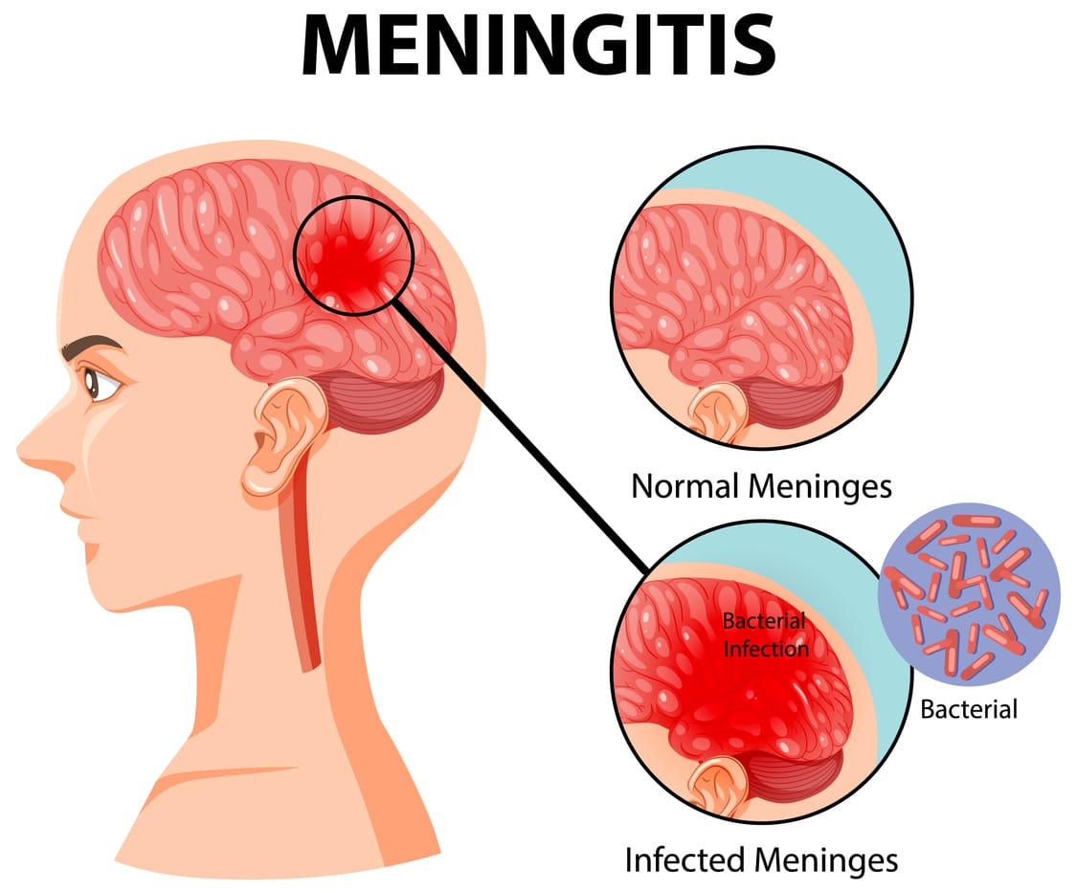
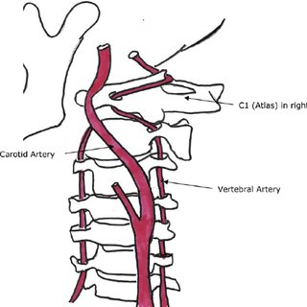
Example: 7. Non-MSK Neck Pain (Slide 1)
1. Meningitis
Subjective: Severe headache, neck stiffness, photophobia, fever, nausea, rapid onset of systemic illness.
Assessment: Vital signs, neurological screen, Kernig/Brudzinski signs (if trained), check for rash, urgent medical referral.
Treatment: Immediate emergency referral — this is a medical emergency.
2. Cervical Arterial Dysfunction (e.g., Vertebral Artery Issues)
Subjective: Dizziness, diplopia, dysarthria, dysphagia, drop attacks, nausea, nystagmus, unilateral neck pain or headache.
Assessment: Vascular risk factor screening, cranial nerve exam, blood pressure, neurological screen. Avoid provocative testing.
Treatment: Urgent medical referral; avoid cervical manipulation or end‑range movements.
Notes:
Menigitis - van de Beek, D., de Gans, J., Tunkel, A. R., & Wijdicks, E. F. (2006). Community-acquired bacterial meningitis in adults. New England Journal of Medicine, 354(1), 44–53.
Cerebral Arterial Dyfunction - Arnold, M., & Bousser, M. G. (2005). Cervical artery dissections: Predisposing factors, diagnosis, and outcome. The Lancet Neurology, 4(9), 668–678.

Slide 5
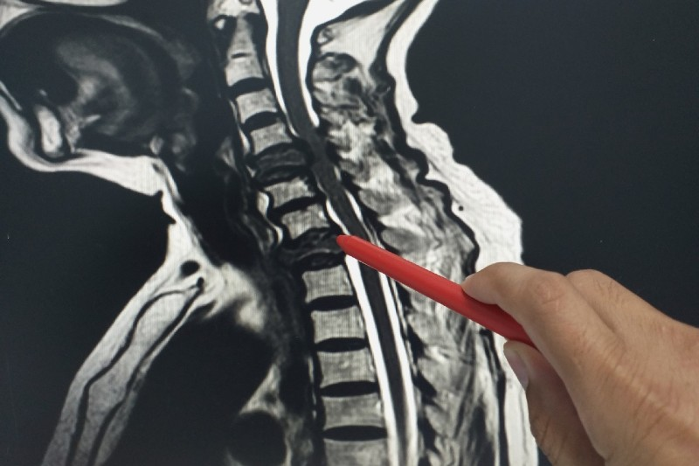
Example: 7. Non-MSK Neck Pain (Slide 2)
3. Tumour / Metastases
Subjective: Unexplained weight loss, night pain, constant non‑mechanical pain, history of cancer, fatigue.
Assessment: Full subjective red‑flag screen, palpation for masses, neurological exam.
Treatment: Medical referral for imaging and oncology input.
4. Infection (Discitis, Osteomyelitis)
Subjective: Severe constant pain, fever, recent infection, immunosuppression, IV drug use, night sweats.
Assessment: Temperature, red‑flag questioning, neurological screen, palpation for local heat/swelling.
Treatment: Urgent medical referral for blood tests, imaging, and antibiotics.
Notes:
3. Tumor - Henschke, N., Maher, C. G., Refshauge, K. M., et al. (2009). Red flags to screen for malignancy in patients with low‑back pain: Systematic review. BMJ, 339, b3365.
4. Infection - Cottle, L., & Riordan, T. (2008). Infectious spondylodiscitis. Journal of Infection, 56(6), 401–412.

Slide 6
Degenerative Conditions
Common Subjective Symptoms:
Pain worsening with activity/ Easing with rest
Headaches
Stiffness
Previous neck injury
Common Objective Symptoms:
Redness/ Discolouration upon observation
Limited ROM
Chronic Pain
Numbness
Best Treatments:
Patient Education/ Manual Therapy
Expected Timeline for Healing: Anywhere from a few weeks to 6 months

Slide 7
2. Disc pathology
Conditions | Subjective Symptoms | Objective details | 2 best treatment | Timeline for healing
Cervical disc herniation | Radiating pain Paresthesia Motor weakness Altered sensation | Hyporeflexia Motor weakness Sensory loss (pin prick or light touch) Positive Spurlings sign | Physical therapy , chin tucks, isometric neck strengthening Medications, NSAIDs, muscle relaxers Surgical intervention | 4 –8 months
Cervical radiculopathy | Direct pressure in cervical region Unilateral neck pain Shooting, sharp or lancing pain radiating down the arm | Possible numbness, weakess in dermatome and mytome testing Reflex changes in c5,c6,c7 such as weakness or absent bicep, brachioradialis, triceps reflex Pain on PROM and AROM neck extension, rotation, lateral flexion | -Joint mobilisation with targeted cervical spines exercises -Postural correction of the cervical spine and surrounding structures | 3-6 months
Cervical Myelopathy | Clumsy hands Sensory changes numbness, tingling and pins and needles in hands and arm Gait and balance issue Neck Pain stiffness and reduced ROM | -generalized hyperreflexia Spasticity Positive babinski or Hoffman sings Gait abnormalities | -Postural education of the cervical spine and other structures -Gentle cervical range of motion | 6-12 months full recovery post surgery
Disc putrusion / extrusion | Neck pain, sharp Radicular pain down the arm Subjective muscle weakness Numbness and tingling | -restricted neck range with pain Positive spurlings test Altered sensation Objective musvcle weakness | Conservative treatment. Pain management, PT, activity modification Surgical treatment | 6 – 12 months

Slide 8
3. Mechanical/Postural pain
Subjective symptoms:
Pain- dull, aching
Stiffness- affect range of motion
Tension headaches
Poor posture
Objective details:
McKenzie method special test
Forward head, kyphosis in observation
Tenderness in palpation
Reduced and pain at end of range of motion
Weakness in muscle strength test
Best treatments:
Patient education on ergonomics and posture- eg take breaks from sitting down
Strengthening exercises for neck and shoulder
Manual therapy- active range of motion, stretches
Expected timeline for healing:
Few weeks- 6-8 weeks

Slide 9
4. Instability/trauma
Myroslava
Joanna
Stephanie
Whiplash-associated disorder
Subjective symptoms
Neck pain/ stiffness- appear within 24-48hrs
neck stiffness and difficulty moving your head
headaches
pain in the shoulders and arms
Objective symptoms:
Reduced ROM
Paresthesia in UL
Muscle spasm and tenderness
Treatment:
Early mobalization
Education
Avoid prolong immobilization
strengthening of deep flexors
Address psychological factors
Timeline – 2/3 months
Cervical fracture
Symptoms:
pain at the fracture site – on movement and when pressure is applied
reduced range of movement in the neck and surrounding areas
reduced muscle power in the neck muscles
reduced mobility
reduced balance
difficulty moving in bed or standing up from sitting
Assessment:
mechanism of injury
assessment of neck range of motion
neck pain
mid line cervical spine tenderness
CT scan
X-Ray
Sensory, motor, reflex examination
Treatment:
Immobilization: with a rigid cervical collar - up to 8w
Pain management
Traction up to - 12w
Airway Management if needed
Surgery
Rehab Healing time: 6mo-1year+

Slide 10
4. Instability/trauma
Myroslava
Joanna
Stephanie
Cervical facet dislocation
Symptoms:
severe neck pain( sudden onset)
Neck stiffness
Paresthesia in UL
Pain radiating in shoulder and UL
Objective:
Restrictive ROM
Sensory loss and muscle weakness
Reflex changes
Postural deformity and muscle spasm (muscle guarding)
Treatment
Spinal immobilization
Education on posture
Bed mobility training
Pain management ( heat/cold application)
Deep neck flexors activation
Healing timeline – 3/6 months
Cervical ligamentous sprain
Symptoms: localized cervical pain
Stiffness
Occipital headache
Shoulder/ upper traps pain
Assessment:
Reduced ROM
Muscle spasm/guarding
Localized tenderness on palpation
Pain provoked with passive stretching ( positive ligament stress test)
Treatment:
Patient education
Deep neck flexors activation
Stretching
Exercises
Progressive cervical strengthening
Healing timeline- 1-12 weeks (depending how severe the case is)

Slide 11
5. Neural Conditions
Condition | Subjective Symptoms | Objective Findings | 2 Key Treatments | Timeline
Cervical Radiculopathy | Neck → arm pain Dermatomal paraesthesia Myotomal weakness Reduced reflexes Worse ext/rotation | ↓ Cervical AROM Neuro exam Spurling’s positive | Cervical traction Deep neck flexor strengthening | 6 weeks conservative Refer 6–8 weeks if no improvement Immediate if neuro worsening
Occipital Neuralgia | Sharp, shooting pain from base of skull Unilateral headache Tender scalp Pain aggravated by neck movement | Palpation of greater occipital nerve (reproduction of pain) Upper cervical ROM testing Cervical joint assessment (C1–C3) | Soft tissue release (suboccipitals) Postural correction | 4–6 weeks trial Manual therapy Postural correction Soft tissue release Education
Thoracic Outlet Syndrome | Diffuse arm pain Whole-hand paraesthesia Heaviness Worse overhead ± Vascular symptoms | Postural deficits Adson’s / Roos positive 1st rib restriction Non-dermatomal pattern | Postural retraining Scapular strengthening | 6–12 weeks rehab Refer 8–12 weeks if no improvement Immediate if vascular signs

Slide 12
6. Inflammatory / Systemic
Subjective Symptoms: (Red flags...)
1 – Constant/unrelenting pain
2- Fever & chills, night sweats
3- Unexplained weight loss
4- Persistent fatigue
Objective Symptoms:
1- Reduced ROM
2 – Neuro deficits: Myelopathy – gait instability, hand clumsiness, spasticity. Radiculopathy – Reduced reflexes, muscle weakness
3- Raised inflammatory markers (blood testing)
Best treatment:
1- Physical therapy – isometrics (resisted lateral flexion) , stretching (lev scap stretch), Mobility (chin tucks, rotations)
2- Postural Adjustment – education on postural alignment
3- Traction
4- Heat and cold therapy – reduces stiffness and pain
5- DMARDs (medical) aggressive tx – suppress overactive immune response
Timeline:
Acute – can see improvements in 1-7 days
Subacute – 2-12 weeks
Long-term recovery – 3-12 months
Rheumatoid Arthritis > can lead to atlanto-axial joint subluxation ​
Ankylosing Spondylitis > fusion and stiffening of cervical vertebrae

